Slide 1
Project 1: Performance Analysis & Recommendation
done BY: Janet mushava

Slide 2
Analyzing how the pandemic has had an impact on the airline industry vs the overall market
Covid 19 affected every aspect of our lives and the stock market is no exception. Let’s take a deep dive into the airlines industry and how it was impacted by Covid 19.
Why was the airline industry so badly affected by the pandemic?
Is the industry performance a reflection of the entire sector?
Would an investor benefit more from a diversified portfolio over an industry focused portfolio?

Slide 3
Breaking down the components
The objective of this project was to analyze the overall market and see how it performed over a 1 year pandemic period vs a specific sector’s performance vs a specific industry and whether or not it made more sense for an investor to bet on one industry or choose a diversified overall market.
Overall Market Analysis- SPY (most diverse)
Industrials Sector Analysis- XLI
Airlines Industry Analysis- JETS (least diverse)
Timeline- 3/1/20-3/1/21

Slide 4
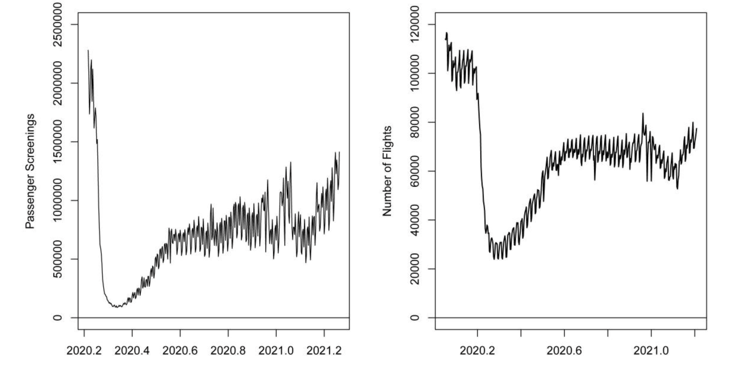
1. Why was the airline industry so badly affected by the pandemic?
Economic uncertainty
GDP went down by 18%
Unemployment rate to rose to 14.7%
Fear of contagion
Airport screenings dropped from 2.6 million to 95,000
Airline operating costs
U.S. carriers’ 2020 net losses topped $35 billion and despite efforts to cut costs, they were still higher than revenues

Slide 5
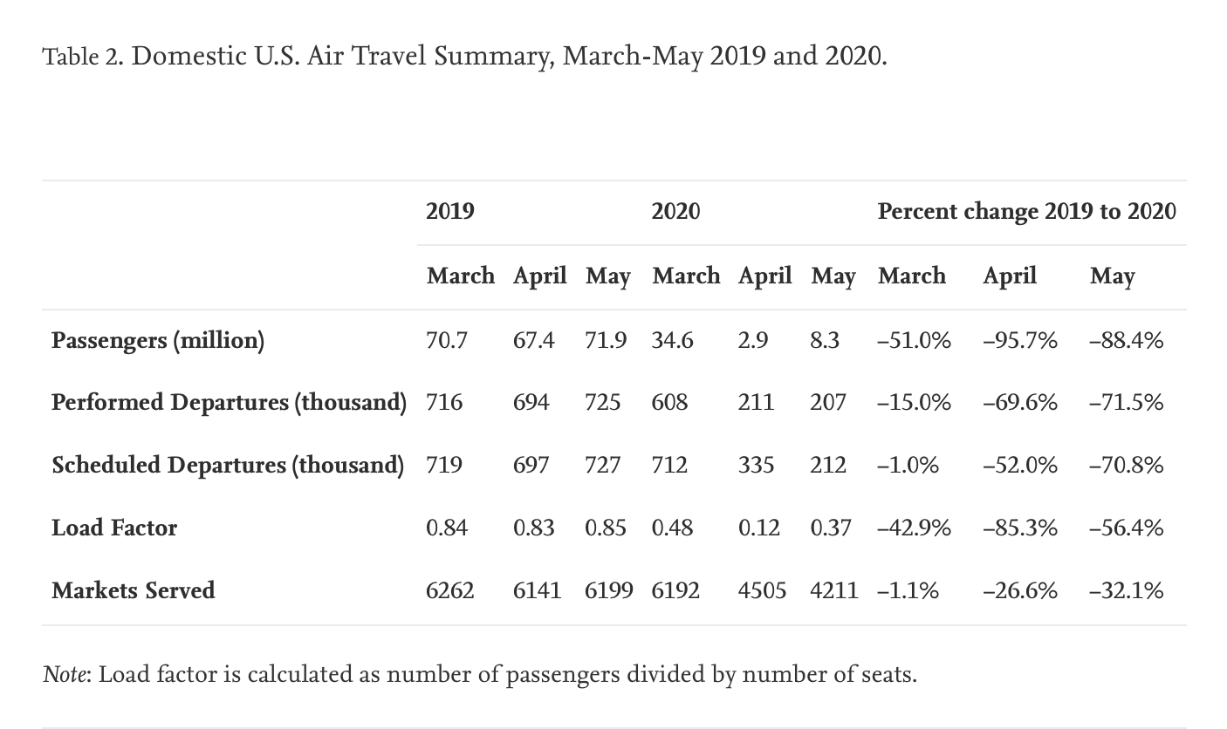
1. Why was the airline industry so badly affected by the pandemic?
Travel restrictions
Suspended entry, quarantine requirements and/or vaccine requirements for travel
Investor sentiments
People were afraid to travel, people had no money to spend and demand for travel plummeted. This triggered a selloff of airline stocks.

Slide 6
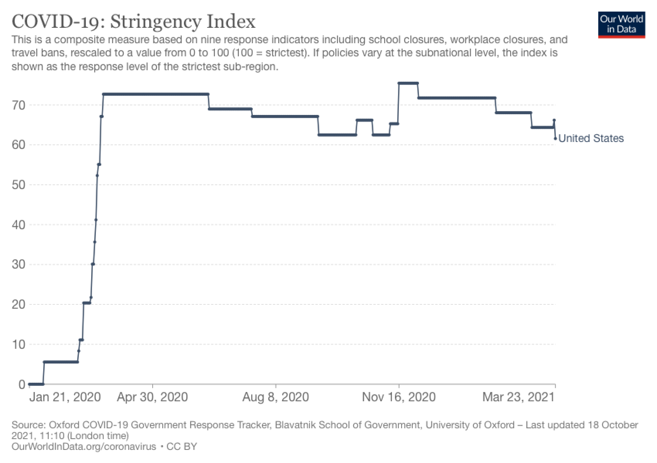
1. Why was the airline industry so badly affected by the pandemic?
US Stringency index
This is a composite measure based on nine response indicators. As the level of stringency decreased, the airline industry performed better.

Slide 7
2. Is the industry performance a reflection of the entire sector?
Factors to consider:
Standard deviation
Volatility
Correlation
Beta
Sharpe Ratio
Combined Returns vs Covid Timeline

Slide 8
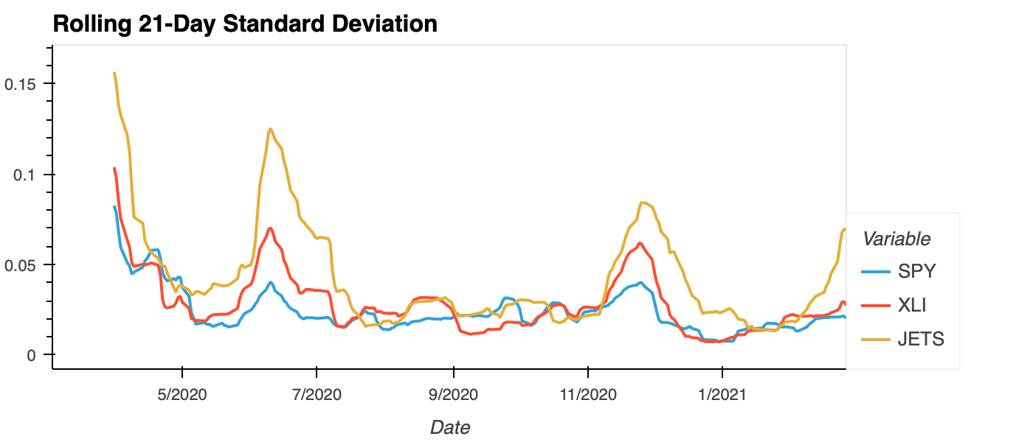

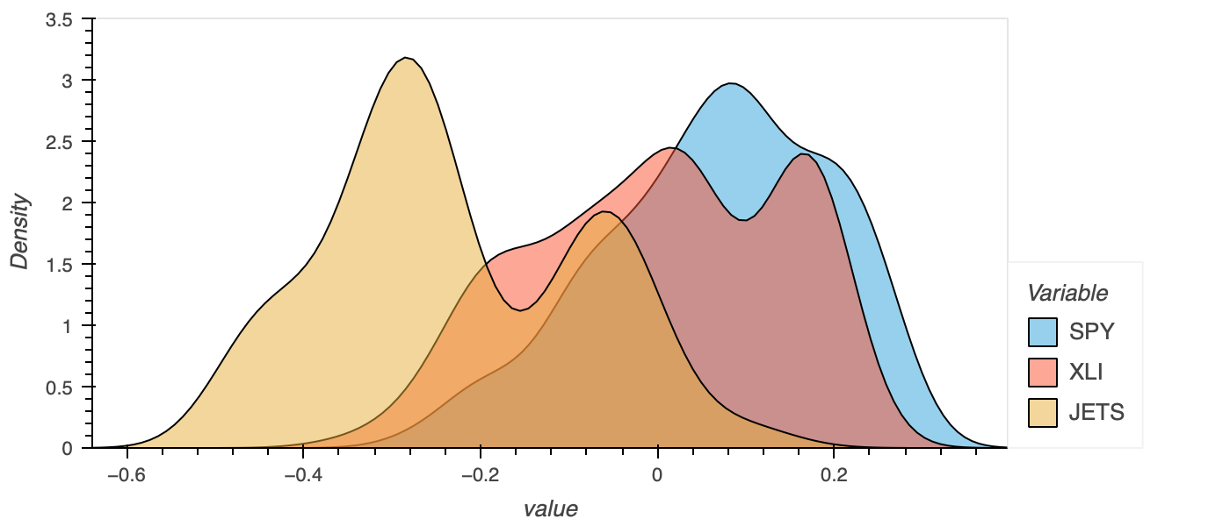
Standard Deviation
Looking at the standard deviation calculation plot, JETS has a higher standard deviation than SPY and XLI which results in it being more volatile.
Density Plot to show Volatility
Using the density plot, we can measure the volatility of the stock. The less volatile the stock, the smaller the standard deviation value. A smaller standard deviation means that the stock is less likely to have large changes in value.

Slide 9
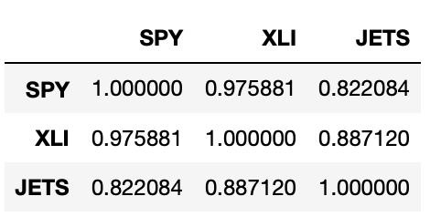
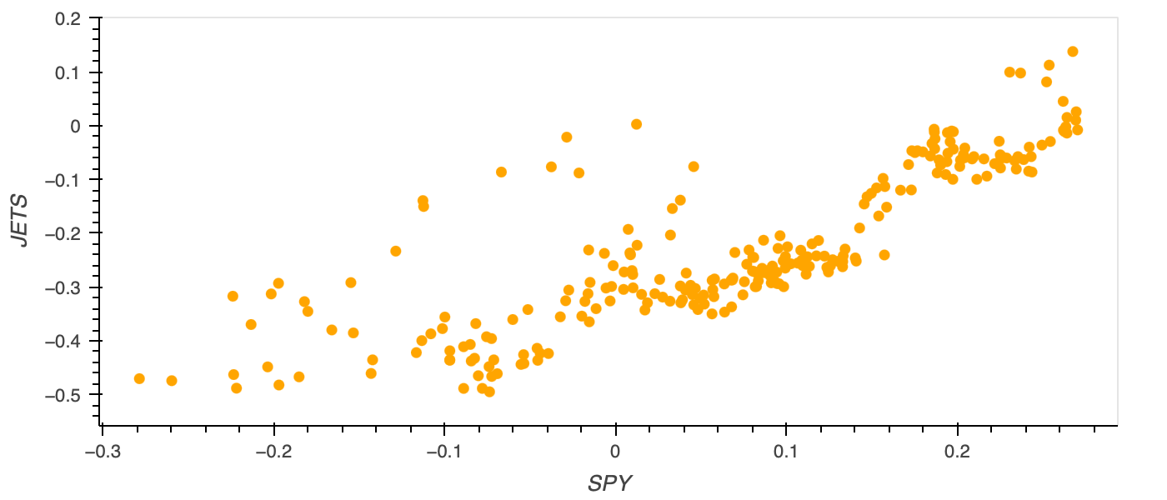
Correlation

Slide 10

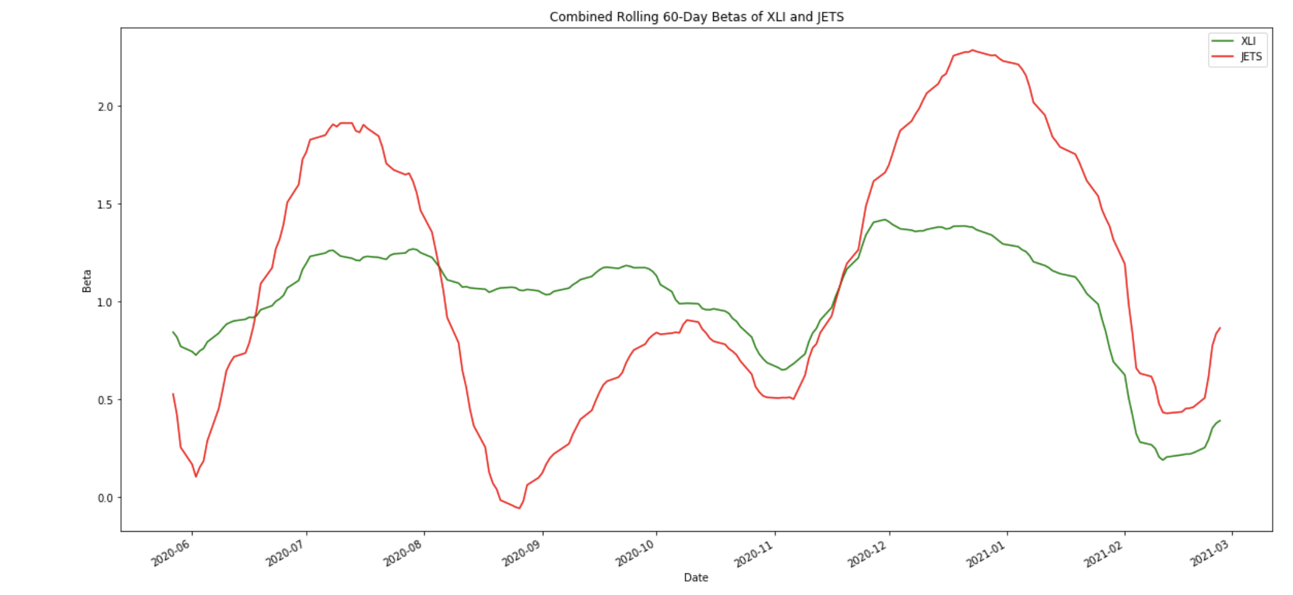
Combined Beta

Slide 11
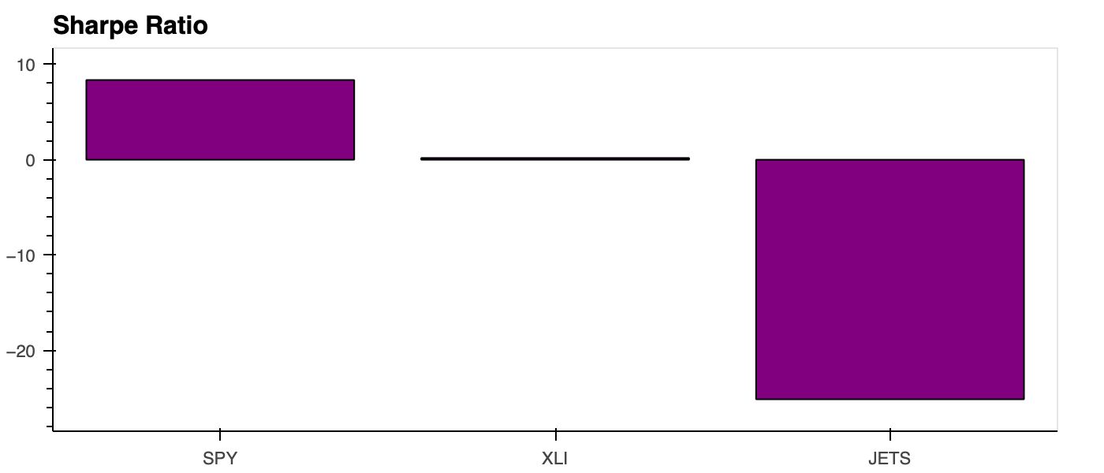

Slide 12
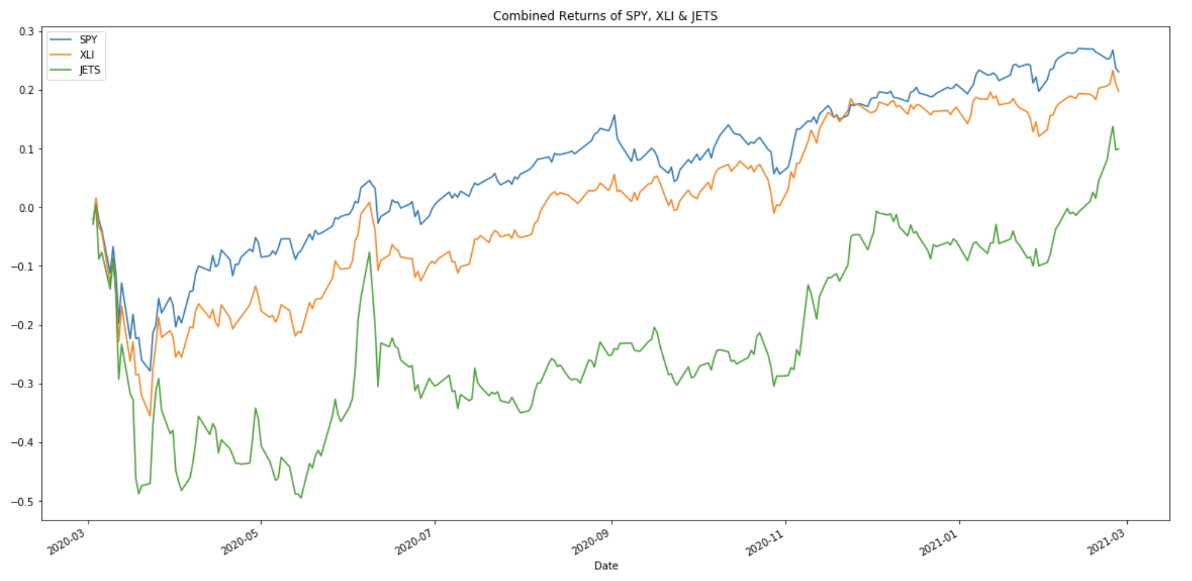
Combined Returns vs Covid Timeline
Jan-March 2020: pre-covid
March- April 2020: covid
June- Nov 2020: second wave
Jan- March 2021: post-vaccine

Slide 13
2. Is the industry performance a reflection of the entire sector?
Overall, the industry underperformed both the sector and the overall market, and the above financial analysis shows that the industry was not able to compensate the investor for the risk and volatility they would assume if they only invested in the airlines industry.

Slide 14
3. Would an investor benefit more from a diversified portfolio over an industry focused portfolio?
Investor profile
Risk tolerance- low
Age- 55
Time horizon- 10 years
Asset type- stocks
Investment amount- $100,000

Slide 15
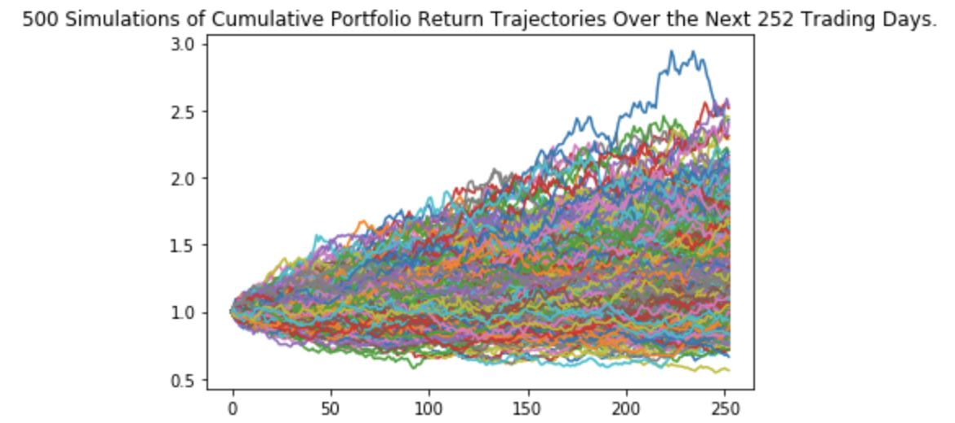
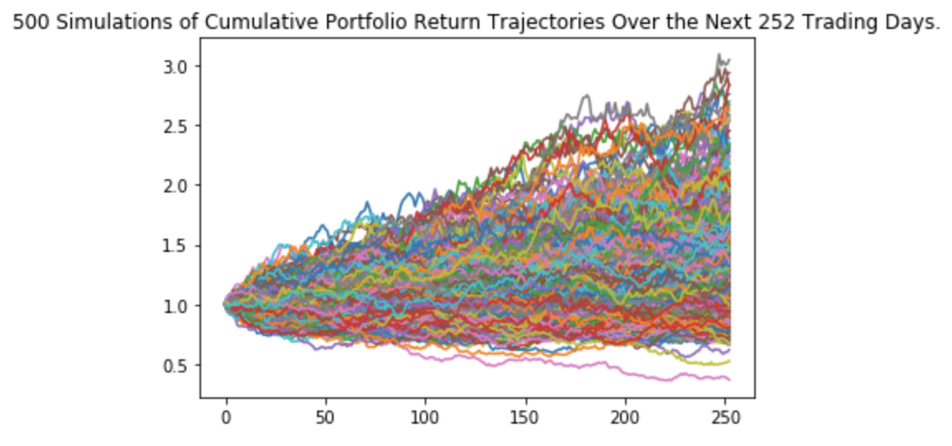
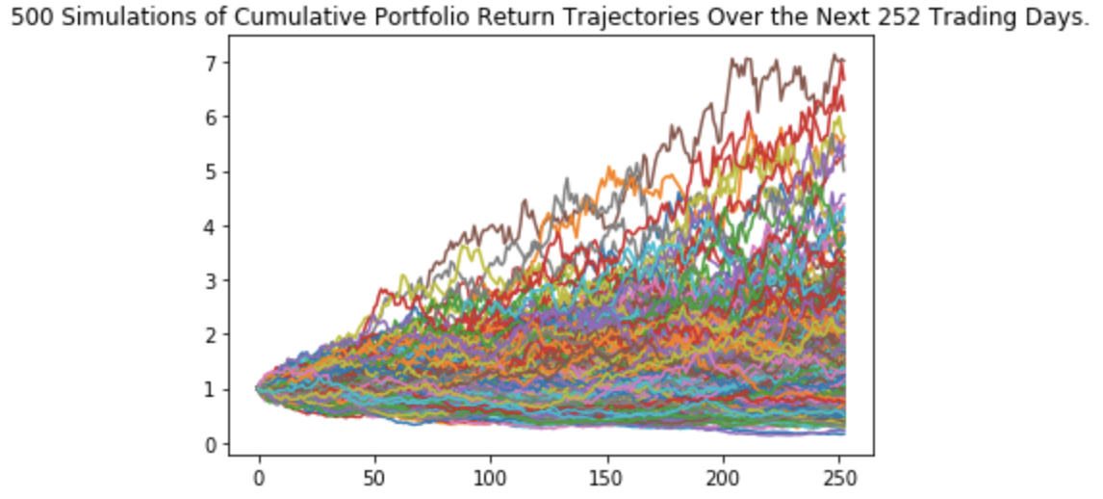
Monte Carlo Simulations for three portfolios
Equal
SPY
JETS
There is a 95% chance that an initial investment of $100,000 in the portfolio over the next 10 years will end within in the range of $76,730.6 and $211,202.7
There is a 95% chance that an initial investment of $100,000 in the portfolio over the next 10 years will end within in the range of $72,962.97 and $245,073.37
There is a 95% chance that an initial investment of $100,000 in the portfolio over the next 10 years will end within in the range of $35,906.17 and $394,562.73

Slide 16
3. Would the investor benefit more from a diversified portfolio over an industry focused portfolio?
After looking at all three simulations, the portfolio breakdown with the highest upside potential is the portfolio with a majority of JETS stock.
However, I would not recommend this portfolio to the investor because it does not align with the investor’s profile.
The JETS portfolio is both the riskiest and the most volatile portfolio out of all three.
The investor has a low risk tolerance so I would recommend the evenly distributed portfolio.
By investing across asset classes, markets, industries and sectors, an investor can hedge against market volatility as well as reduce the risk of the overall portfolio.

Slide 17

Thank you for your time! Any Questions? ☺

